Slide 1
Diagenetic and Compositional Controls of Wettability in Siliceous Sedimentary Rocks, Monterey Formation, California
Kristina Hill
CSULB 2013

Slide 2
Presenter Background
Kristina Hill
Education:
B.S. Geology, CSU Long Beach, Dec 2009
B.A. Geography, CSU Long Beach, Dec 2009
Work Experience:
Geoscience Tech at Occidental Petreoleum
March, 2010 to present

Slide 3
Abstract
How much do these factors affect Monterey Formation rock wettability?
Silica diagenesis
Carbonate content
Clay content
Brine chemistry
Crude oil chemistry
Long Beach MARS Project: Monterey and Related Sediments

Slide 4
Introduction
Background
Wettability is …
The relative affinity between a surface and a fluid.
the product of the hydrostatic intermolecular interactions between the rocks and a fluid phase (Hirasaki, 1991, as cited in Civan, 2004)
Wettability affects
location, flow and fluid distribution (Karabakal and Bagci, 2003).
And is affected by
Temperature, fluid chemistry, rock mineralogy, secondary, or non-matrix rock constituents (clay, carbonate, clastics, etc.)
Notes:
Figure 1. Contact angle. An oil drop (green) surrounded by water (blue) on a water-wet surface (left) forms a bead. The contact angle θ is approximately zero. On an oil-wet surface (right), the drop spreads, resulting in a contact angle of about 180°. An intermediate-wet surface (center) also forms a bead, but the contact angle comes from a force balance among the interfacial tension terms, which are γ_{so} and γ_{sw} for the surface-oil and surface-water terms, respectively, and γ_{ow} for the oil-water term. (Abdullah, et al., 2007)

Slide 5
Introduction
Importance of project
Monterey Shale - 64%, or 15.42 BBO recoverable shale oil in the U.S. (Intek, 2011).
Highly underdeveloped due to inefficient recovery (Montgomery and Morea, 2001)
Low k and ϕ due to tight matrix.
Wettability important to effective exploitation as a result.
May be an important control on hydrocarbon distribution?
Long Beach MARS Project: Monterey and Related Sediments
Notes:
Hydrocarbon distribution largely credited to pore throat size/geometry currently.

Slide 6
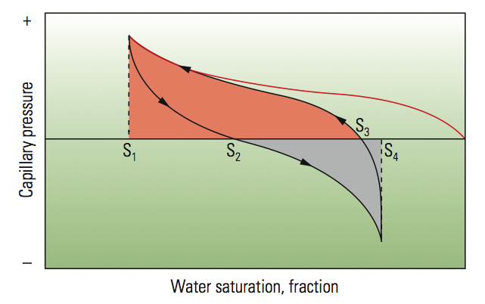
Previous Work - Monterey Siliceous Rock Wettability
Montgomery & Morea (2001) - Antelope Shale Characterization
Spontaneous imbibition tested on opal-CT* and sandstone samples.
(rock type not specified, so presumably both detritus poor porcelanites and porcelanite-siltstones)
Opal-CT Results:
Oil recovery up to 70.7% of initial So
initial water saturations: Sw = 0.68
Large oil recovery + negligible oil imbibition = moderately to strongly water wet
Supported by a high Amott wettability index of +0.78 (deZabala, 1999, as cited in Montgomery & Morea, 2001).
Long Beach MARS Project: Monterey and Related Sediments
Notes:
- The opal CT rock types mentioned were 2 of the four studied in the paper, along with clay poor sandstones and siltstone-sandstones, and were subjected to core analysis.

Slide 7
Previous Work - Monterey Siliceous Rock Wettability
Toronyi (1997) - Antelope shale reservoir characterization
Buena Vista Hills Field
Field and lab wettability tests
Array of samples from a single core
Lab tests did not produce results by the time of publication
Field tests results: most samples neither strongly oil wet nor strongly water wet.
Sandstone laminae and samples below 4570 feet deep = water wet.
No distinctions between rock types or stages of silica diagenesis in the samples tested.
Long Beach MARS Project: Monterey and Related Sediments
Notes:
Because of tight permeabilities
Field wettability tests: Dispersion test: sample crushed, ½ sample put in jar of brine, ½ in a jar of kerosene. A water wet sample will totally disperse in the brine and clump at the bottom of the kerosene.
Drop tests: (samples chosen that were not in contact with drilling mud) –
Brine: sample placed in a depolarized kerosene filled beaker. A drop of crud oil placed under the sample. The shape of angle of incidence observed.
Oil: beaker filled with produced brine, drop of produced crude placed under sample
Lab wettability tests – cleaning started Jan ‘97,at publication, one more month expected until cleaning process finished
My hope is that oil migration in Monterey rocks is not as preoccupied with time scales as grad students are, so the wettability tests are not irrelevant.

Slide 8
Previous Work – Carbonate wettability with Organics and Temp
Thomas & Longo (1993)
Test:
Calcite and dolomite crystals subjected to contact angle wettability measurements with deionized water and a dodecane/adsorbant mixture over a range of temperatures.
Results
Carbonates are strongly oil wet in the presence of fatty acid adsorbates at room temperature
Intermediate wet in the presence of carboxylic acids.
At high temperatures, calcite becomes more water-wet with increasing temperature
At reservoir temperatures fatty acids are expected to adsorb, making carbonate reservoirs oil wet
Long Beach MARS Project: Monterey and Related Sediments
Notes:
Related to our study on crude oil impact on wettability
- Dodecane is a liquid alkane hydrocarbon

Slide 9
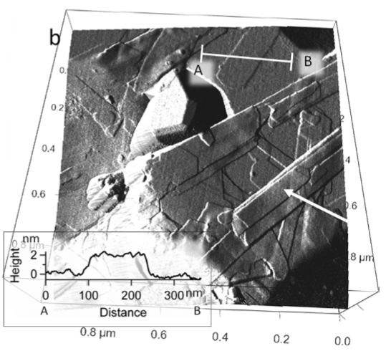
Previous Work – Chalk wettability with clay
Skovjberg et al. (2013)
Method:
Atomic force microscopy and chemical force mapping of North Sea Chalk samples
Findings:
Location of oil in the sample tied to location of clay particles and organics
Clay and organic material cause wettability alterations, not calcite
Distinct increase in the wettability of chalk particles to oil in the presence of clays
Atomic Force Microscopy
Long Beach MARS Project: Monterey and Related Sediments

Slide 10
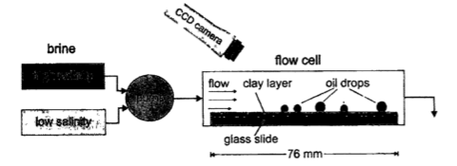
Previous Work – Impact of clay + salinity on wettability
Berg et al. (2010)
Test:
Brine flowed through a controlled medium over a glass slide with attached clay particles
Results
Dramatic increase in oil removal from a clay covered glass slide with the reduction of solution brine salinity
Wettability of the clay particles changed from oil wet to water wet in the presence of low salinity water.
Consistent with previous waterflood data
Increased production with injected water salinities lower than original formation water.
Long Beach MARS Project: Monterey and Related Sediments
Notes:
- “pump” is actually a gravity-driven reservoir

Slide 11
Previous Work – Impact of Salinity + pH on wettability
Abdallah et al. (2007)
Test:
Contact angle measurements made on a glass surface conditioned with NaCl solution, then aged in crude oil
Test salinities: 0.01. 0.1 and 1.0 mol/mm³
Tested pH values: 4, 6 and 8
Results:
Glass surface retained a water wetting tendency when conditioned in high pH, high salinity water
The same surface altered to oil wetting when conditioned with low salinity, low pH water.
Higher concentrations of resins and asphaltenes increase wettability to oil.
Long Beach MARS Project: Monterey and Related Sediments
Notes:
- These results are consistent with Berg et al., (2010) despite the change of substrate examined. Wettability tests on Monterey Formation rocks are expected to produce similar results.
- These trends are expected to remain consistent in Monterey Formation Reservoir rocks.

Slide 12
Hypothses/Tests
Test: The influence of different compositional and diagenetic variables on wettability of siliceous sedimentary rocks
Silica diagenesis
Clay content
Carbonate Content
Brine & crude oil chemistry
Crushed rock method
To allow the measurements to proceed in a reasonably efficient time frame
Imbibition tests on low perm rocks can take months to process a single sample (Toronyi, 1997)
Use of crushed, sieved and limited fragment size to provide large, constant initial surface areas for interaction with oil and brine.
Long Beach MARS Project: Monterey and Related Sediments

Slide 13
Methods
XRD/XRF
Grain density measurement
Amott-Harvey/USBM wettability factor determination
Multivariate statistics
Sample selection:
100 samples collected and characterized
20 samples measured
A suite of sample that represent a continuum of compositional and diagenetic ranges appropriate to the Monterey Formation reservoirs
Samples will be collected from outcrop, unless a sufficient amount and type of core samples is available. Can any of the affiliates help?
Long Beach MARS Project: Monterey and Related Sediments

Slide 14
Objectives/Deliverables
Final produced data:
XRD & XRF analysis results
Grain density measurements
Wettability factors
Multivariate Statistical Analysis
Correlation between controlled variables and wettability factor results
Long Beach MARS Project: Monterey and Related Sediments

Slide 15
Alternative Method
NMR – Nuclear Magnetic Resonance
A spectrometer may also be used for wettability measurements
Measurement: the relaxation time of fluids in pore spaces
Premise: the fluid in contact with the mineral surface has a relaxation time shorter than its bulk volume.
Values proven to correspond with Amott-Harvey indices (Chen et al., 2006)
Long Beach MARS Project: Monterey and Related Sediments
Notes:
- Surface relaxation of the wetting phase in a rock results in shorter relaxation times than would otherwise be observed for the bulk fluid. The nonwetting-phase fluid Molecules do not come into contact with the pore surfaces, and therefore their relaxation time is the same as in the bulk fluid. – (Freedman et al., 2003)

Slide 16
Input?
Questions
Concerns
Advice
Long Beach MARS Project: Monterey and Related Sediments

Slide 17
References
W. Abdallah, J. S. Buckley, A. Carnegie, J. Edwards, B. Herold, E. Fordham, A. Graue, T. Habashy, N. Seleznev, C. Signer, H. Hussain, B. Montaron and M. Ziauddin, Fundamentals of wettability, Oilfield Review, 2007, 19(2):44-61
S. Berg, A. W. Cense, E. Jansen and K. Bakker (2010); Direct experimental evidence of wettability modification by low salinity, Petrophysics (Houston, Tex.), October 2010, 51(5):314-322
(Chen et al., 2006)
F. Civan, Temperature dependence of wettability related rock properties correlated by the Arrhenius equation, Petrophysics (Houston, Tex.), August 2004, 45(4):350-362
U. Karabakal and S. Bagci, Determination of wettability and its effect on waterflood performance in limestone medium, Energy & Fuels, April 2004, 18(2):438-449
"Review of Emerging Resources: U.S. Shale Gas and Shale Oil Plays." Independent Statistics and Analysis U.S. Energy Information Administration. U.S. Energy Information Administration, July 2011, Web. 18 Aug. 2013.
S. L. Montgomery and M. F. Morea, Antelope Shale (Monterey Formation), Buena Vista Hills Field: Advanced Reservoir Characterization to Evaluate CO2 Injection for Enhanced Oil Recovery, AAPG Bulletin, April 2001, v. 85, p. 561-585,
L. L. Skovbjerg, D. V. Okhrimenko, J. Khoo, K. N. Dalby, T. Hassenkam, E. Makovicky, and , S. L. S. Stipp, Preferential Adsorption of Hydrocarbons to Nanometer-Sized Clay on Chalk Particle Surfaces, Energy & Fuels, July 2013, 27(7):3642-3652
M. M. Thomas, J. A. Clouse, J. M. Longo, Adsorption of organic compounds on carbonate minerals: 1. Model compounds and their influence on mineral wettability, Chemical Geology, October 1993, 109(1–4):25 pp.201-213
Long Beach MARS Project: Monterey and Related Sediments

